Slide 1

PBL presentation for Skills and Competency Evaluation(SCE) Microcontroller And Applications (ETUA22202)(SY ETC SEM-II AY 22-23 )
Automatic window blinds
Div.:- A
By: Group No. – A27
Roll No. | G.R. No. | Name of Student | Contact number
211031 | 22111340 | Nagesh kinagi | 9049926363
211036 | 22110505 | Vaishnavi patare | 9373765507
211037 | 22111313 | Ketu patel | 7972128378
211038 | 22110016 | Aditya Patil | 9022162512
Name of instructor: Dr. Pravin G. Gawande
Department of Electronics and Telecommunication Engineering
BRACT’S, Vishwakarma Institute of Information Technology, Pune-48
(An Autonomous Institute affiliated to Savitribai Phule Pune University) (NBA and NAAC accredited, ISO 9001:2015 certified)
1

Slide 2
OUTLINE
AIM
OBJECTIVES
HARDWARE MATERIALS ARE REQUIRED AND SPECIFICATIONS
DESIGN (BLOCK DIAGRAM)
INTERFACING DIAGRAM ON PROTEUS
WORKING DESCRIPTION
ALGORITHM/FLOWCHART
PROGRAM IMPLEMENTATION
HARDWARE IMPLEMENTATION
RESULTS AND CONCLUSION
REFERENCES
12. TITLE OF PAPER IMPLEMENTED USING PBL
Department of Electronics and Telecommunication Engineering, VIIT, Pune-48
2

Slide 3
AIM
Our aim is to provide a convenient and efficient way solution for traditional manual window blinds which requires physical manipulation to adjust the position of the blinds and control the amount of light entering the room.

Slide 4
OBJECTIVES
The primary objective of the automatic window blind system is to improve energy efficiency by reducing the amount of heat that enters the room during hot summer days and minimizing heat loss during cold winter nights. By automatically adjusting the position of the blinds based on the ambient light level in the room, the system can help regulate the indoor temperature and reduce energy consumption for heating and cooling.
Another objective of the automatic window blind system is to provide convenience to the user. With the automatic system, the user does not need to manually adjust the blinds to control the light entering the room. The system can adjust the blinds based on the time of day and the user's preference, providing a more comfortable and relaxing environment.
Overall, the objective of the automatic window blind system is to provide an
energy-efficient, convenient, and cost-effective solution for controlling the amount of light and heat that enters a room through a window.

Slide 5
HARDWARE MATERIAL REQUIRED AND SPECIFICATIONS
Arduino
LDR
TB66
Johnsons Motor
12 v Battery
JOHNSONS MOTOR
12 V BATTERY

Slide 6
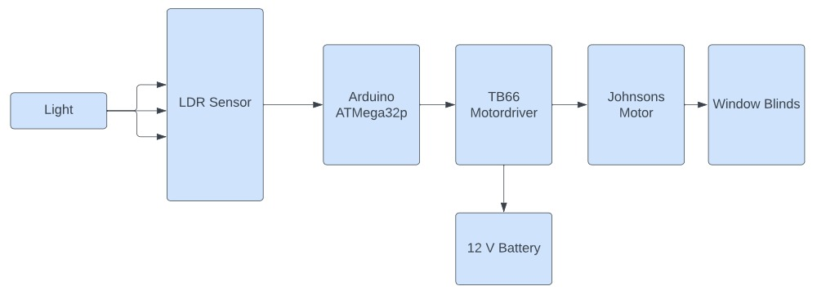
DESIGN (BLOCK DIAGRAM)

Slide 7
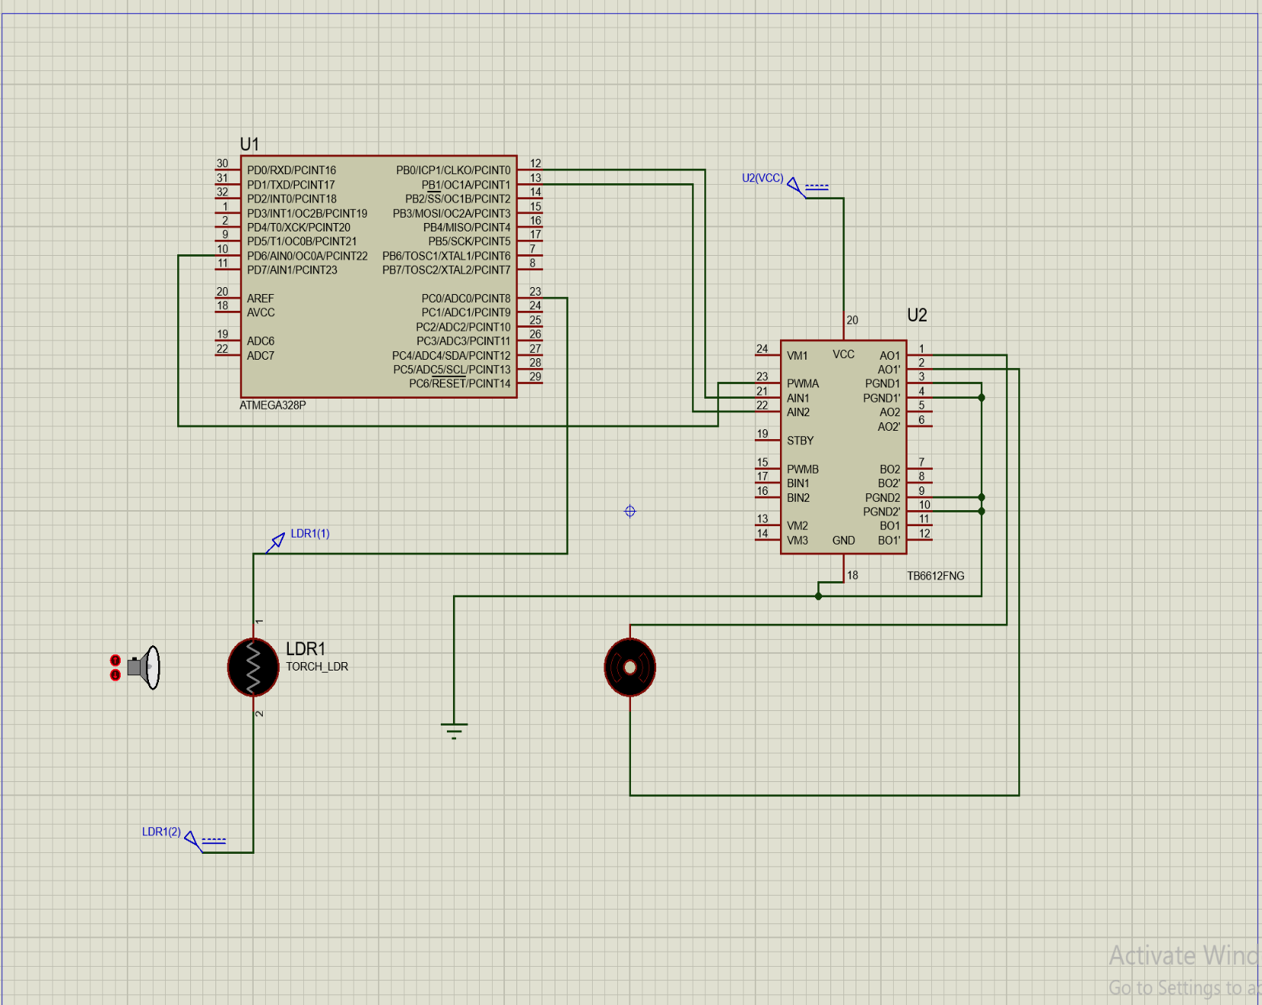
INTERFACING DIAGRAM ON PROTEUS

Slide 8
Working
The sensors detect changes in the environment such as changes in light or temperature.
The control unit receives signals from the sensors and processes them.
Based on the signals received, the control unit activates the motor to open or close the blinds.
If the blinds are programmed to open and close at specific times, the control unit activates the motor at the scheduled times.
The blinds open or close automatically, providing privacy, security, and light control.

Slide 9
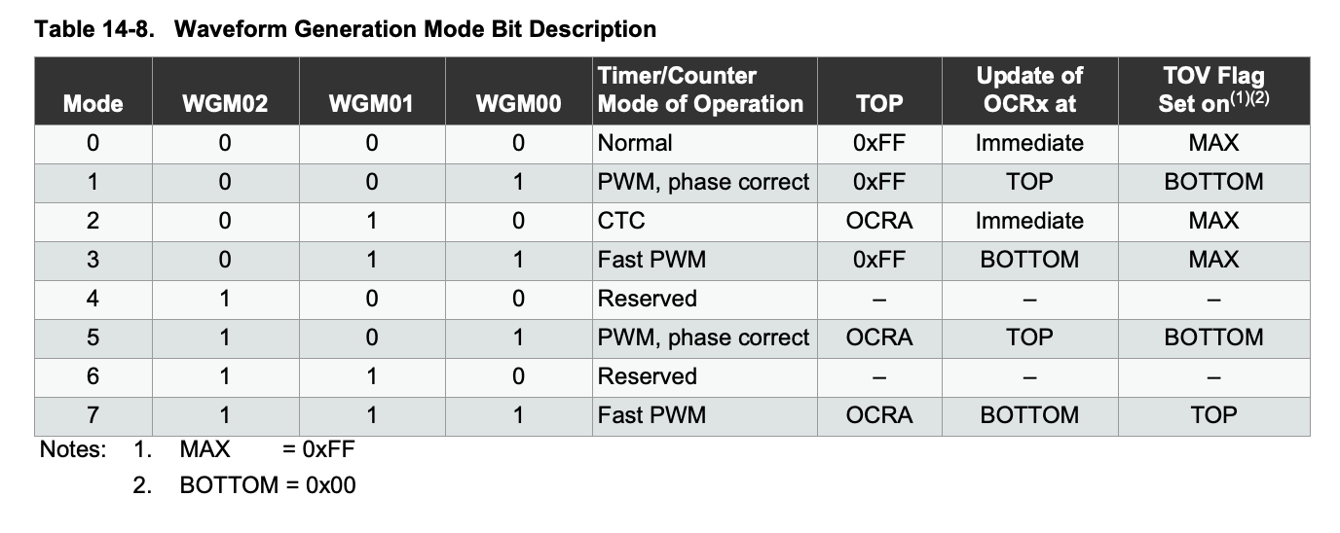

Slide 10
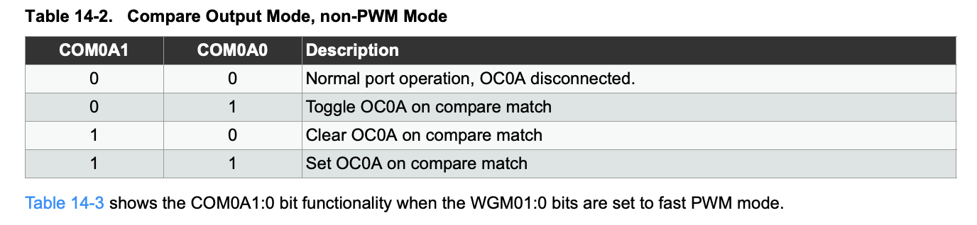
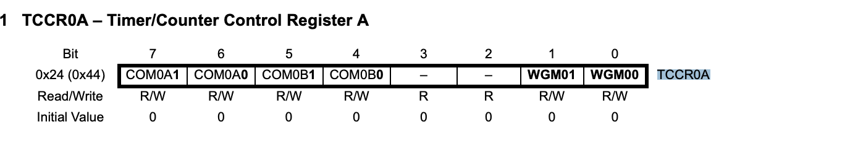

Slide 11
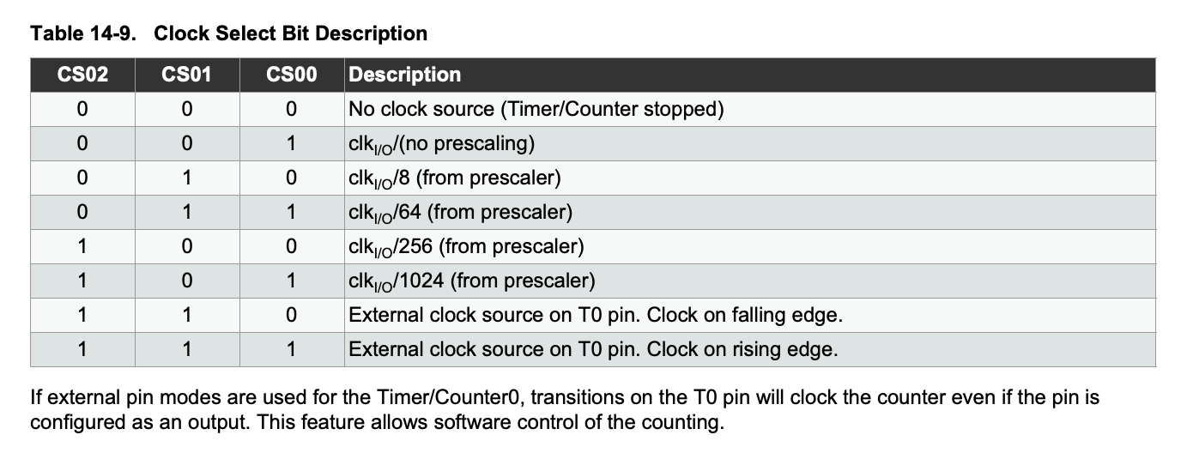

Slide 12
ALGORITHM/FLOWCHART
Step 1)Initialize the system by setting up the Arduino board and connecting the motor driver, motor, and LDR sensor.
Step 2)Set the motor driver pins as output pins and the LDR sensor pin as an input pin.
Step 3)LDR Senses Light
Step 4)Information is Fed to Arduino

Slide 13
ALGORITHM/FLOWCHART
Step 5)Arduino Tricks the motor driver which is connected to 12 v battery
Step 6)Motor has 2 input pins(1 & 2 )
Step 7).Input is sent to motor driver and Motor moves Anti-clockwise or clockwise
Step 8)Repeat steps 4 to 7 continuously.

Slide 14
PROGRAM IMPLEMENTATION
TCCR0B |= (1<<CS01)|(CS00);
Source code used in Arduino:
TCCR0B &= (~(1<<CS02));
#include <avr/io.h>
DDRD |= (1<<DDD5) | (1<<DDD6);
#include <util/delay.h>
while (1)
#define F_CPU16000000UL;
{
int main(void)
OCR0A=75;
{
if(PINC==0b00000001)
DDRD=0xFF;
{
DDRC=0x00;
PORTB=0b00000001;
DDRB=0xFF;
_delay_ms(500);
TCCR0A |= (1<<WGM01)|(1<<WGM00); //FAST PWM
}
TCCR0B &= (~(1<<WGM02));
else
{
PORTB=0b00000010;
TCCR0A |= (1<<COM0A1);
_delay_ms(500);
TCCR0A &= (~(1<<COM0A0));
}
TCCR0A |= (1<<COM0B1);
}
TCCR0A &= (~(1<<COM0B0));
}

Slide 15
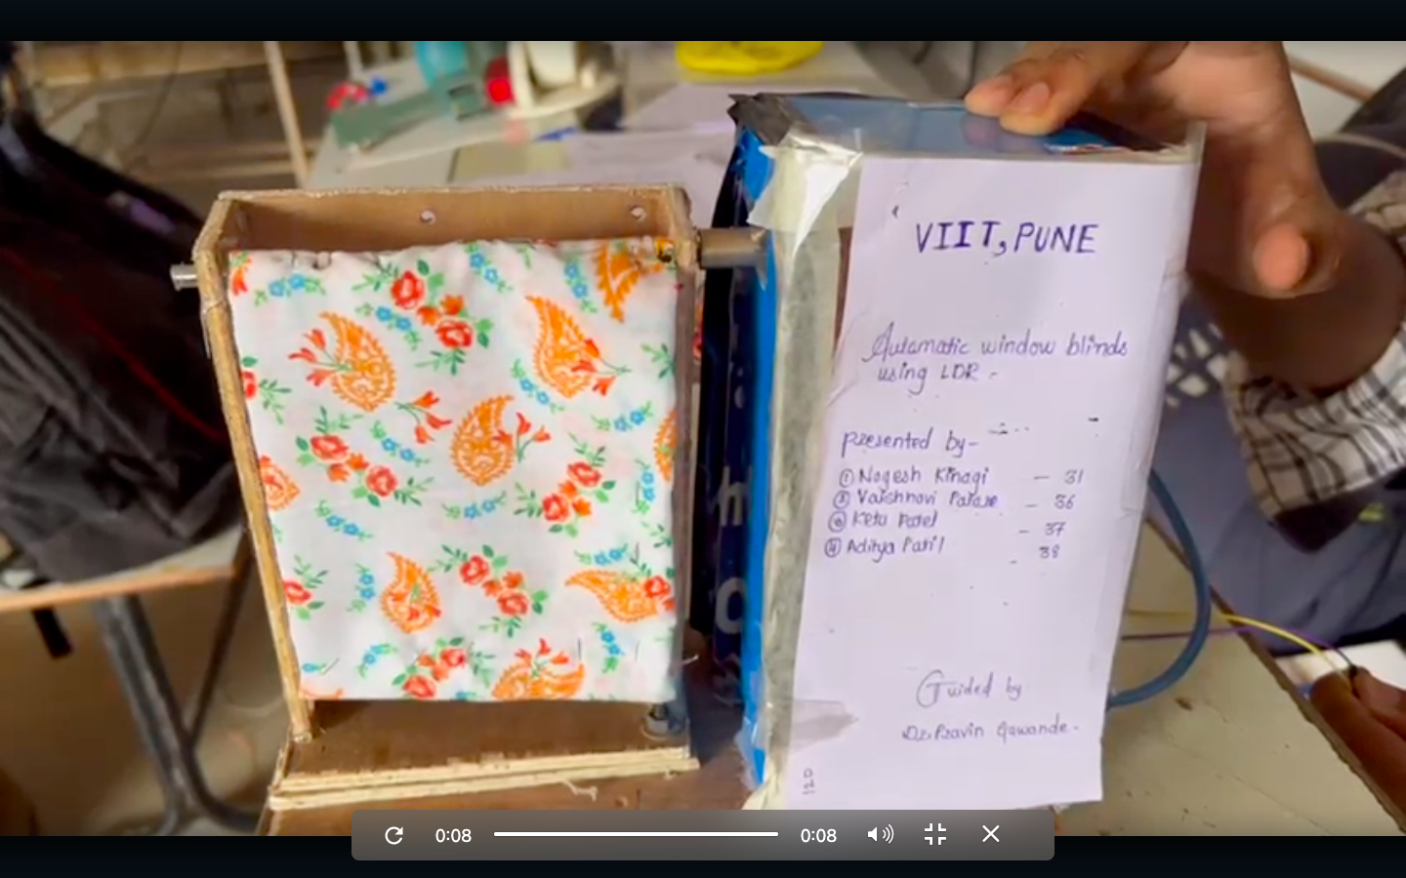
HARDWARE IMPLEMETATION

Slide 16
RESULTS AND CONCLUSION
1)Through the implementation and testing of the system, it was found that the automatic window blinds provided an efficient and convenient way to regulate the amount of natural light entering a room. The system successfully adjusted the blinds in response to changing lighting conditions, resulting in a more comfortable indoor environment and potential energy savings.
2) Overall, the results of the project demonstrated the feasibility and benefits of using automation technology to control window blinds. The project also highlighted the potential for further development and improvement of the system, such as incorporating remote control or integrating with other smart home devices.

Slide 17
REFERENCES
Vorrath, Sophie. "Top 10 Technologies to Double Energy Efficiency, Deliver Zero Emissions." Renew Economy. N.p., 11 Mar. 2015. Web. 06 Feb. 2017.
D. Priest, ‘The CNET Smart Home Antes Up for Smart Blinds', 2016. [Online]. https://www.cnet.com/news/the-cnet-smart-home-antes-up-for-smart-blinds/.
Amit Tiwari (2015): Design and Fabrication of Automatic Window Blind” International Journal of Emerging Technology and Innovative Engineering, ISSN: 2394 –6598, Volume I, Issue 2, pages 456-471.
Kim, J.-H, Park, Y.-J., Yeo, M.-S. and Kim, K.-W. (2007): “An Experimental study on the environmental performance of the automated blind in summer,” Building and Environment, Volume. 4, No. 7, pages 1517-1527.
https://www.instructables.com/Automatic-CurtainWindow-Blind-Using-Arduino-and-LD
https://circuitdigest.com/microcontroller-projects/arduino-based-roller-blinds-project-to-automate-and-control-window-curtains-using-nodemcu-and-stepper-motor
http://www.diva-portal.org/smash/get/diva2:1462132/FULLTEXT01.pdf
https://www.pinterest.com/pin/project-videos-on-youtube--637400153496864246/
https://www.scribd.com/document/398275398/Smart-Blinds-System-using-LDR
https://forum.arduino.cc/t/controlling-stepper-motor-using-ldr-automatic-blinds/701033

Slide 18
TITLE OF PAPER IMPLEMENTED USING PBL
"Design and Implementation of an Automatic Window Blind System Using IoT Technology"

